Slide 1
Connecting to Sewer Services
Project 23 Wells Place
Virtual Meeting
Presented by Fayetteville PWC
September 13, 2021
6:30 p.m.
Presentation/Recorded Meeting available: //www.faypwc.com/annexation-project23/
Notes:
6:15- Open, ppt
6:25- record
6:30- Turn on video, show participants, chat
Introduction
Host of tonight’s meeting
Meeting is being recorded, will be on the PWC website
Questions thru chat, captured

Slide 2
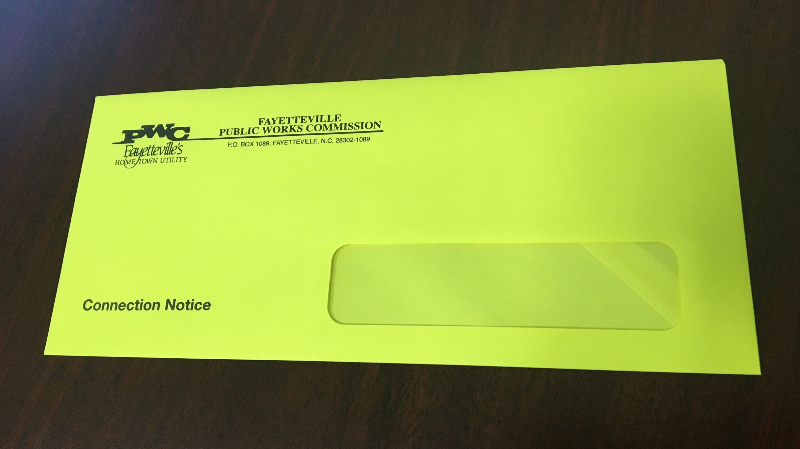
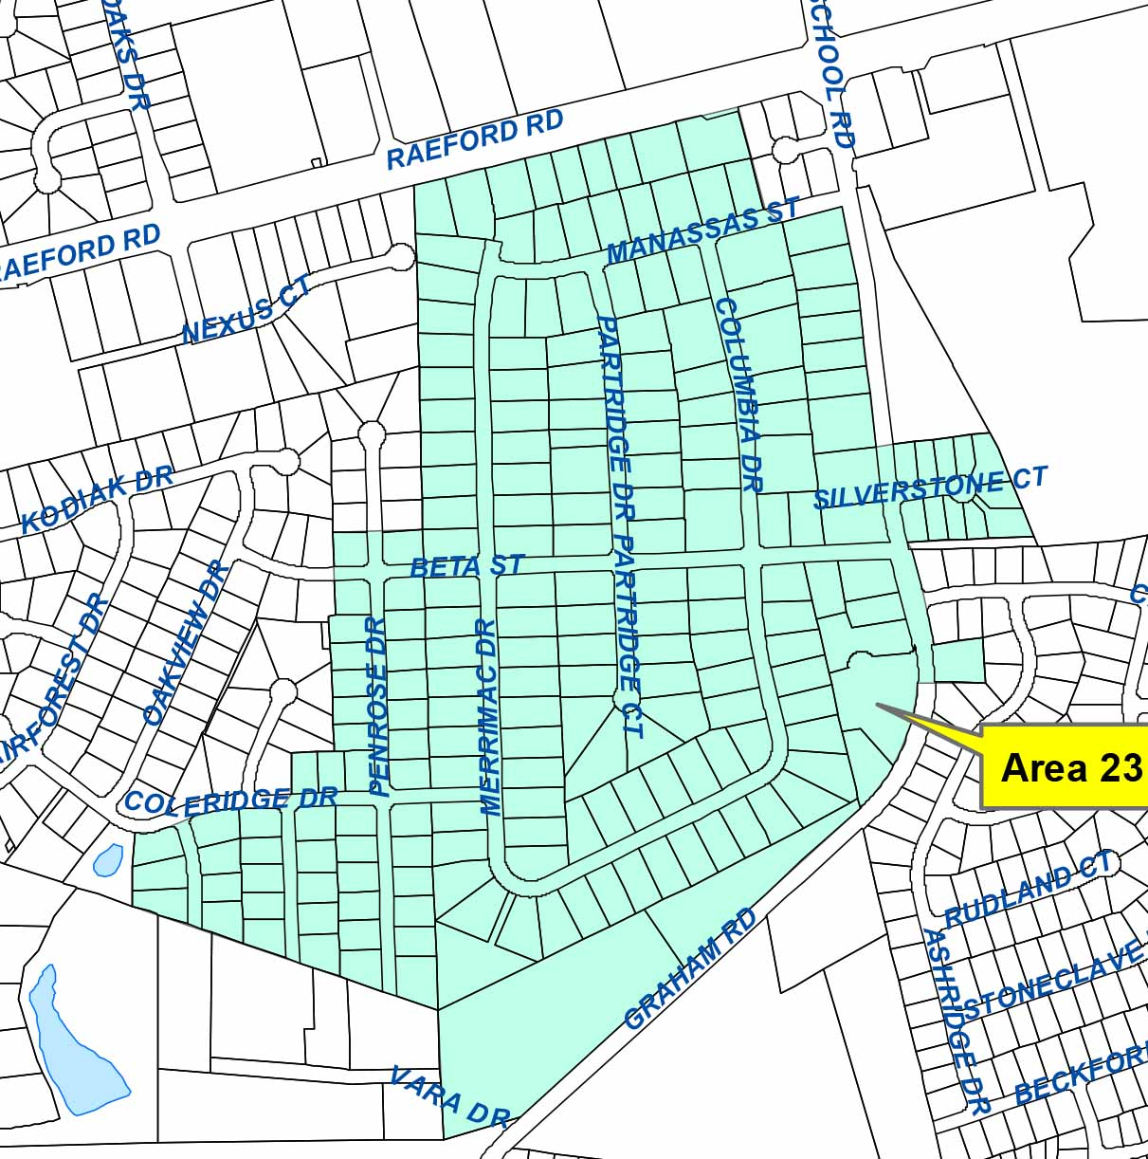
Tonight’s meeting Project 23 Wells Place Connection is now available
Notes:
Tonight’s meeting- Project 23
Received yellow meeting notice
Will be receiving official connection notice next week
Details (dates) specific to area 23
Material referenced in ppt- on website
Receive a brochure with connection notice

Slide 3
Tonight’s Meeting
Post Construction/Paving
Steps to Connecting to Sewer Service
Tips for Hiring a Plumber
What Happens To Your Septic Tank
How Sewer is billed
Breakdown Costs Related to Sewer Connection & Assessments
Review Assessment Process
Ask Questions Using Zoom Chat feature
Notes:
Agenda for tonight/Who is at meeting
W/R Engineering
Plumber’s Association-best practices
COF Inspections- permits, specs
Customer Programs- setting up account
Taking questions thru chat

Slide 4
Construction within this project area is complete. This includes sanitary sewer installation, pavement patching, and restoration.
There is a one-year warranty on this project for any workmanship issues.
PWC will perform a 6-month and 1 year warranty review. Any issues will be addressed at that time.
Should you have any issues with restoration or construction, please contact PWC at (910) 223-4730.
The streets within the neighborhood will be added to the City of Fayetteville’s Resurfacing Contract and will be overlaid in 12-18 months.
Construction Completion and Warranty AJ Riddle PWC Water Resources Engineering
Ask Questions Using Zoom Chat feature
Notes:
Intro Allan Riddle
Chat reminder
Afterwards- mute Allan

Slide 5
Connecting to Sanitary Sewer
This process involves changing your home’s plumbing from the existing septic tank to the newly installed sewer system.
Your wastewater will then go through the sewer system to the PWC treatment plant to be cleaned and returned to the Cape Fear River.

Slide 6
Notes:
Illustration shows PWC sewer mains installed with the project (also on PWC web)
Area of connection to your home’s plumbing – will provide this details

Slide 7
Steps to Connecting to Newly Installed Sewer Services
PWC’s UCC is waived.
Ask Questions Using Zoom Chat feature
Notes:
Costs discussed- there are 2 separate cost for property owners- connection & assessment
Property owner pays for the cost of the connection
Not required to connect but responsible for assessment
If you connect in the first 6 months- it is less because the UCC fee associated with the connection is waived.
FIF currently $1107
May quality for assistance- Contact the City of Fay Community Development BEFORE connection
Decide to Connect? Hire a plumber or do it yourself
If you do it yourself, most live in the home, responsible for obtaining permitting/inspection

Slide 8
Hire a plumber or DIY
PWC has a list of licensed, local plumbers on web & handout.
PWC does not endorse, promote or prefer any specific plumber. This list is for informational purposes only and the selection of a vendor is the sole responsibility of the customer.
The licensees listed have certified that they pay taxes to Cumberland County or employ at least two (2) CC residents at a place of business within CC.

Slide 9
Plumber tips Fayetteville Area Plumbers Association
Every property is different- location/distance of cleanout vs home plumbing, landscaping
Get at least 3 quotes- in person where they can give proper evaluation of your property/plumbing
Avoid phone quotes
Some plumbers use on-line mapping to provide quotes, may not be accurate
Consider local plumbers & ask other residents for experiences
“You get what you pay for”- Cheaper is not always better
Establish post-work expectations before work starts: cleanup, fill-in, landscaping
Plumbers work guaranteed for life of work; if plumber ‘offers’ warranty, they are already, by law, required to provide it
If connecting before waiver ends, schedule early:
Work must be complete and inspected by waiver deadline
Demand on plumbers/connections increases near deadline
No plumber can get PWC to make an ‘exception’ & extend waiver deadline.
Ask Questions Using Zoom Chat feature
Notes:
Intro Phillip Woods – Plumbers Association (unmute)
Carl Johnson- City of Fay Inspections (unmute)
Remind of Chat

Slide 10
What happens to my septic tank?
Must be completely disconnected.
Currently, there are no plumbing code requirements for existing septic tanks when connecting to sewer service.
The Cumberland County Health Department, for safety purposes, recommends pumping out the septic tank then crushing and filling in with soil.
Notes:
Mute plumber/inspections before next slide

Slide 11
Your PWC Account/Billing PWC Customer Programs (910) 223-4600
Do you already have a PWC account?
How PWC knows you are connected
You call PWC (or)
PWC receives inspections report
When will billing start?
What are the monthly charges?
If you don’t have PWC water- you are billed a flat rate
Ask Questions Using Zoom Chat feature

Slide 12
Sample bill with sewer charges
Sample Sewer Bill
with Aqua water services
or well

Slide 13
Property Owner Costs
 | Not Connecting | Connect before waiver deadline Deadline is Feb. 28, 2022 | Connect after waiver deadline
Assessment Cost to install mains and service laterals and shared by the property owners, and PWC. | $5,000 | $5,000 | $5,000
Utility Connection Charge (UCC)* A fee for all new users of PWC's sewer/water systems, which helps offset the impact of expansion on our treatment plants. Annexed properties have FIF waived if connection is made within 6 months of service becoming available. | $0 | $0 | $1107*
Plumbers Fee Paid directly to plumber; amount determined by job/plumber | $0 | Plumber’s quote | Plumber’s quote
Monthly Sewer Bill* Begins once connected; billed based on water usage if customer has PWC water; billed as flat fee if another water provider | $0 | PWC Water customer $5.35 per 1,000 gallon* Aqua water customer Flat fee- $39.40 | PWC Water customer $5.35 per 1,000 gallon* Aqua water customer Flat fee- $39.40
Utility Deposit- if applicable | $0 | $64* | $64*
*As of July 1, 2021. Will pay current amount as of connection date.
 | Not Connecting | Connecting in 6 months | Connecting after 6 months
Assessment Cost to install mains and service laterals and shared by the property owners, and PWC.. | $5,000 | $5,000 | $5,000
Facility Investment Fee (FIF)* A fee for all new users of PWC's sewer/water systems, which helps offset the impact of expansion on our treatment plants. Annexed properties have FIF waived if connection is made with 6 months of service becoming available | $0 | $0 | $1107*
Plumbers Fee Paid directly to plumber; amount determined by job/plumber | $0 | Plumber’s quote | Plumber’s quote
Monthly Sewer Bill* Begins once connected; billed based on water usage if customer has PWC water; billed as flat fee if another water provider | $0 | PWC Water customer- $5.28 per 1,000 gallon* Aqua water customer/Well- $ | PWC Water customer- $5.28 per 1,000 gallon*
Utility Deposit- if applicable | $0 | $64* | $64*
*Current amount. Will pay current amount as of connection date.
Formally known as Facility Investment Fee (FIF)
Notes:
Separate Costs-
Waiver deadline- ???????

Slide 14
Assessments
You are not required to connect; however, you are still responsible for the assessment.
PWC will mail you information on the City Council Assessment Confirmation Public Hearing. (Expect in Fall 2021, Questions: Mark Brown, PWC, 910-223-4224)
City Council confirms the assessment.
PWC mails assessment information and we will hold informational meeting to explain assessments/payment options.
Contact City of Fay- Community Development for assistance eligibility. 433-1599
For all projects related to Annexation Phase V- The City Council has set the assessment for $5,000.
Payment options for the assessment: one-time payment, monthly & yearly payments up to 10 years.
Interest for monthly, annual payments: prime + 2% (Set by City Council; prime as of July 1st)
Ask Questions Using Zoom Chat feature
Notes:
Assessment Cost to install mains and service laterals and shared by the property owners, and PWC.

Slide 15
Connecting to Sewer Services
Presentation/Recorded Meeting available: //www.faypwc.com/annexation-project23/
PWC staff available to answer questions:
Call: 910-223-4600
Email: buildersgroup@faypwc.com
Notes:
Open video
Information available on website
Meeting recording will be available tomorrow

